Slide 1
Research Based Project based on Unsupervised Learning
Guide : DR. Anjali Jivani, dr. hetal bhavsar
Shah Shubham, Yash amin

Slide 2
Questions Asked in Previous Presentation
1) Why to choose K-means algorithm among different clustering algorithm
2) Their exist clustering algorithm (i.e. DBSCAN) which can detect outliers in data then why to detect outliers in K means algorithm ?
3) Why to modify K means algorithm if we are selecting between K means and K medoid ?
4) Purpose and Significance of Data Analysis System ?
5) Why to choose between K means and K medoid only when there are so many clustering algorithms ?

Slide 3
Approach for Detecting Outliers in Data
Steps:
i) Check the distribution of data
ii) If the data is following normal distribution then use Z score Normalization for detecting outliers in data
iii) If the data is not following Normal distribution then one of the following methods can be used for outlier detection
1) Properties of Box and Whisker plot (IQR)
2) Isolation Forest
3 ) LOF 4) One Class SVM

Slide 4
Task 1 : Normality of Data
Single Dimension data : Univariate Normality
Multi Dimension data : Multivariate Normality
As data is dynamic visualization of data is not allowed so it is required to perform statistical tests on data to whether the data is normally distributed or not ?
Hypothesis of Statistical Test
H0 : Data is following univariate/multivariate normal distribution
H1 : Data is not following univariate/multivariate normal distribution

Slide 5
Tests performed for Univariate Normality
Anderson Darling Test
Kolmogorov Smirnov Test
Shapiro Wilk Test
Lilliefors Test
Jarque Bera Test
D’Agostino’s K^2 Test

Slide 6
Tests performed for Multivariate Normality
Mardia’s Skewness and Kurtosis Test
Henze - Zirkler Test
Royston’s Test
Doornik Hansen Test
Shapiro Wilk Test
Energy Test
Jarque Bera Test
Lilliefors Test

Slide 7
Outlier Detection Techniques
Single Dimension data following Normal Distribution
Approach : Apply Z score Normalization on data and separate the data points which are outside 3 Std w.r.t mean . This data points are outliers ( Empirically proved)
Multi Dimension data following Multivariate Normal Distribution
Approach : To be defined

Slide 8
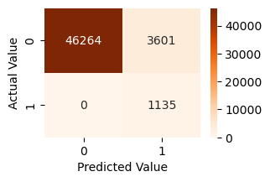
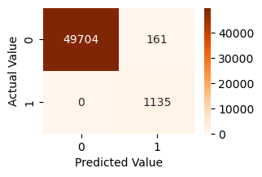
1D Synthetic Data Experiments for Outlier Detection
Data generated is mixture of normal distribution (50000) and uniform distribution (1000)
size: 51000 , Outliers : 1135
Isolation Forest IQR

Slide 9
Single Dimension data not following Normal Distribution
Approach : Use Inter Quartile Range (IQR) and separate the datapoints which are outside either Left Whisker or Right Whisker. This data points are outliers (Empirically Proved)
Multi Dimensional data not following Multivariate Normal Distribution
Approach : To be defined which technique should be used

